Slide 1
PYTHON -INTRODUCTION

Slide 2
PYTHON Applications
GUI PROGRAMMING
GAME DEVELOPMENT
SCRIPTING
SYSTEM ADMINISTRATION
DB APPLICATIONS

Slide 3
PYTHON PLUSES
EXPRESSIVE LANGUAGE
IT IS MORE CAPABLE TO EXPRESSING THE CODE’S PURPOSE THAN MANY OTHER LANGUAGES
SIMPLER SYNTAX
EASY OF USE
CROSS PLATFORM LANGUAGE:
IT CAN RUN EQUALLY WELL ON VARIOUS PLATFORMS-WINDOWS, LINUX, SMARTPHONE ETC.,
PORTABLE LANGUAGE

Slide 4
PYTHON PLUSES
INTERPRETED LANGUAGE:
IT IS AN INTERPRETED LANGUAGE NOT A COMPILED LANGUAGE.
EXECUTES LINE BY LINE
EASY TO DEBUG
COMPLETENESS:
WHEN YOU INSTALL PYTHON YO WILL GET EVERYTHING-ADDITIONAL LIBRARIES-VARIOUS MODULES ETC.,

Slide 5
PYTHON PLUSES
FREE AND OPEN SOURCE :
IT IS FREELY AVAILABLE WITHOUT ANY COST
OPEN SOURCE- CAN IMPROVE, MODIFY, EXTEND
CROSS PLATFORM LANGUAGE:
IT CAN RUN EQUALLY WELL ON VARIOUS PLATFORMS-WINDOWS, LINUX, SMARTPHONE ETC.,
PORTABLE LANGUAGE

Slide 6
PYTHON MINUSES
NOT THE FASTEST LANGUAGE
LESSER LIBRARIES THAN C,JAVA,PEARL
NOT STRONG ON TYPE BINDING
NOT EASILY CONVERTIBLE

Slide 7
TOKENS
SMALLEST INDIVIDUAL UNIT IN A PROGRAM ARE CALLED TOKENS OR LEXICAL UNITSOR LEXICAL ELEMENTS.
The different types of Tokens
Reserved Words
Identifiers
Literals
Operators

Slide 8
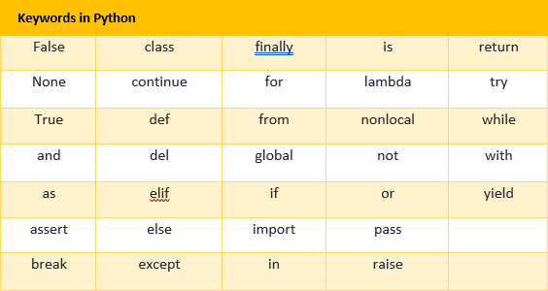
KEYWORDS
RESERVED WORDS
CONVEY A SPECIAL MEANING TO THE LANGUAGE COMPILER /INTERPRETER

Slide 9
IDENTIFIERS
FUNDAMENTAL BUILDING BLOCKS OF THE PROGRAMS
GENERAL TERMINOLOGY FOR THE NAMES GIVEN TO THE DIFFERENT PARTS OF THE PROGRAM
RULES :
UPPER AND LOWER CASES ARE DIFFERENT
DIGITS CAN BE A PART OF AN IDENTIFIER EXCEPT FOR THE FIRST CHARACTER
THE FIRST CHARACTER MUST BE A LETTER OR UNDERSCORE(_)
THESE ARE UNLIMITED IN LENGTH
IT IS CASE SENSITIVE
THEY CANNOT BE KEYWORDS

Slide 10
RULES FOR NAMING AN IDENTIFIER
1. UPPER AND LOWER CASES ARE DIFFERENT
A=25
print A //25
print a error
2. DIGITS CAN BE A PART OF AN IDENTIFIER EXCEPT FOR THE FIRST CHARACTER
A123,S1ER,a1000 ARE THE VALID IDENTIFIERS
1QWE,09ER ARE THE INVALID IDENTIFIERS

Slide 11
RULES FOR NAMING AN IDENTIFIER
3.THE FIRST CHARACTER MUST BE A LETTER OR UNDERSCORE(_).
EG:
AB_CD,_GFH,I_90P ARE VALID
4.THESE ARE UNLIMITED IN LENGTH
5.IT IS CASE SENSITIVE

Slide 12
RULES FOR NAMING AN IDENTIFIER
5.IT CANNOT BE A KEYWORD
if=20,print=‘abc’ are invalid
6.IT CANNOT CONTAIN ANY SPL CHARACTER EXCEPT UNDERSCORE(_)
EXAMPLE:ABC DF,NAME-OF,QW.ER ARE INVALID

Slide 13
IDENTIFY THE VALID AND INVALID IDENTIFIERS
myfile
su_per_PY
ZT12Z
DATA REC
break
FOR
_YOYO

Slide 14
LITERALS
LITERALS ARE ALSO CALLED AS CONSTANTS
LITERALS ARE DATA ITEMS THAT HAVE A FIXED VALUE.
TYPES OF LITERALS
STRING LITERAL
NUMERIC LITERAL
BOOLEAN LITERAL
SPECIAL LITERAL None
OTHER LITERALS- TUPLE,LIST ETC

Slide 15
STRING LITERAL
THE TEXT ENCLOSED IN QUOTES FORMS A STRING LITERAL
EG:’ABCD’,”WELCOME”,”A”
STRING LITERALS CAN BE ENCLOSED WITH IN EITHER SINGLE OR DOUBLE QUOTES.

Slide 16
NON GRAPHIC CHARACTERS
PYTHON ALLOWS YOU TO HAVE CERTAIN NON GRAPHIC CHARACTER IN STRING VALUES.
NON GRAPHIC CHARACTERS ARE THOSE CHARACTERS THAT CANNOT BE TYPED THROUGH KEYBOARD.
IN PYTHON STRINGS, THE BACKSLASH "\" IS A SPECIAL CHARACTER, ALSO CALLED THE "ESCAPE" CHARACTER.
IT IS USED IN REPRESENTING CERTAIN WHITESPACE CHARACTERS: "\t" IS A TAB, "\n" IS A NEWLINE,

Slide 17
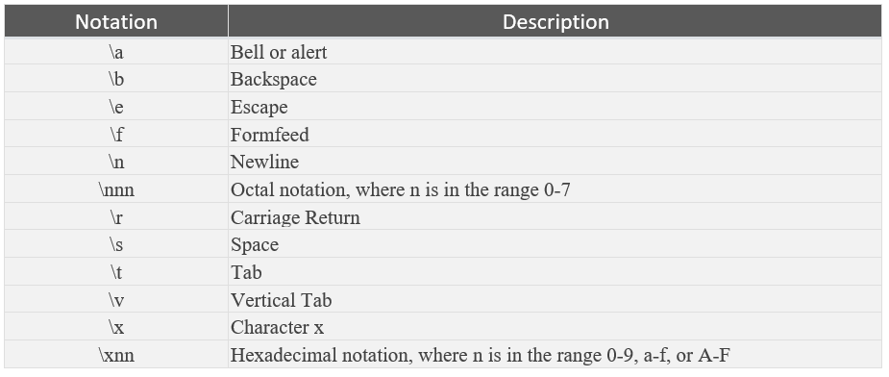
Some escape characters

